Slide 1
Microsoft Azure Fundamentals
Module 1
Dr. Tóth Ádám
toth.adam@inf.unideb.hu

Slide 2
Cloud computing
Notes:
https://learn.microsoft.com/training/modules/describe-cloud-compute/

Slide 3
Microsoft Azure
Azure: cloud computing platform, provides a wealth of cloud-based services.
Cloud-based services:
Remote storage
Database hosting
Centralized account management
New capabilities like AI and Internet of Things (IoT)

Slide 4
Cloud computing
It's the delivery of computing services over the internet, which is otherwise known as the cloud.
These services include:
servers,
storage,
databases,
networking,
software,
analytics,
Intelligence.

Slide 5
Cloud computing
You typically pay only for the cloud services you use:
Lower your operating costs
Run your infrastructure more efficiently
Scale as your business needs change.
Cloud computing is a way to rent compute power and storage from someone else's datacenter.

Slide 6
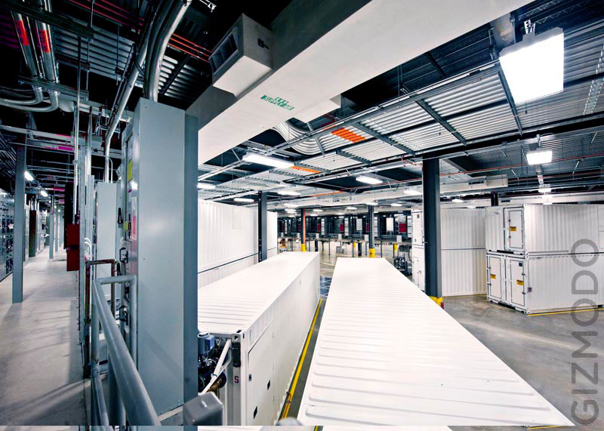

Slide 7
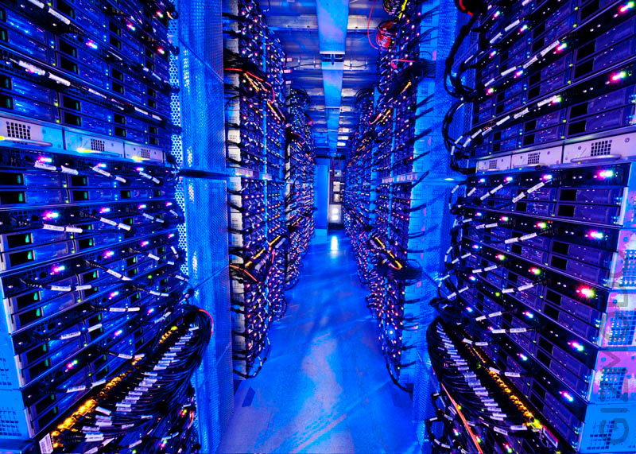

Slide 8
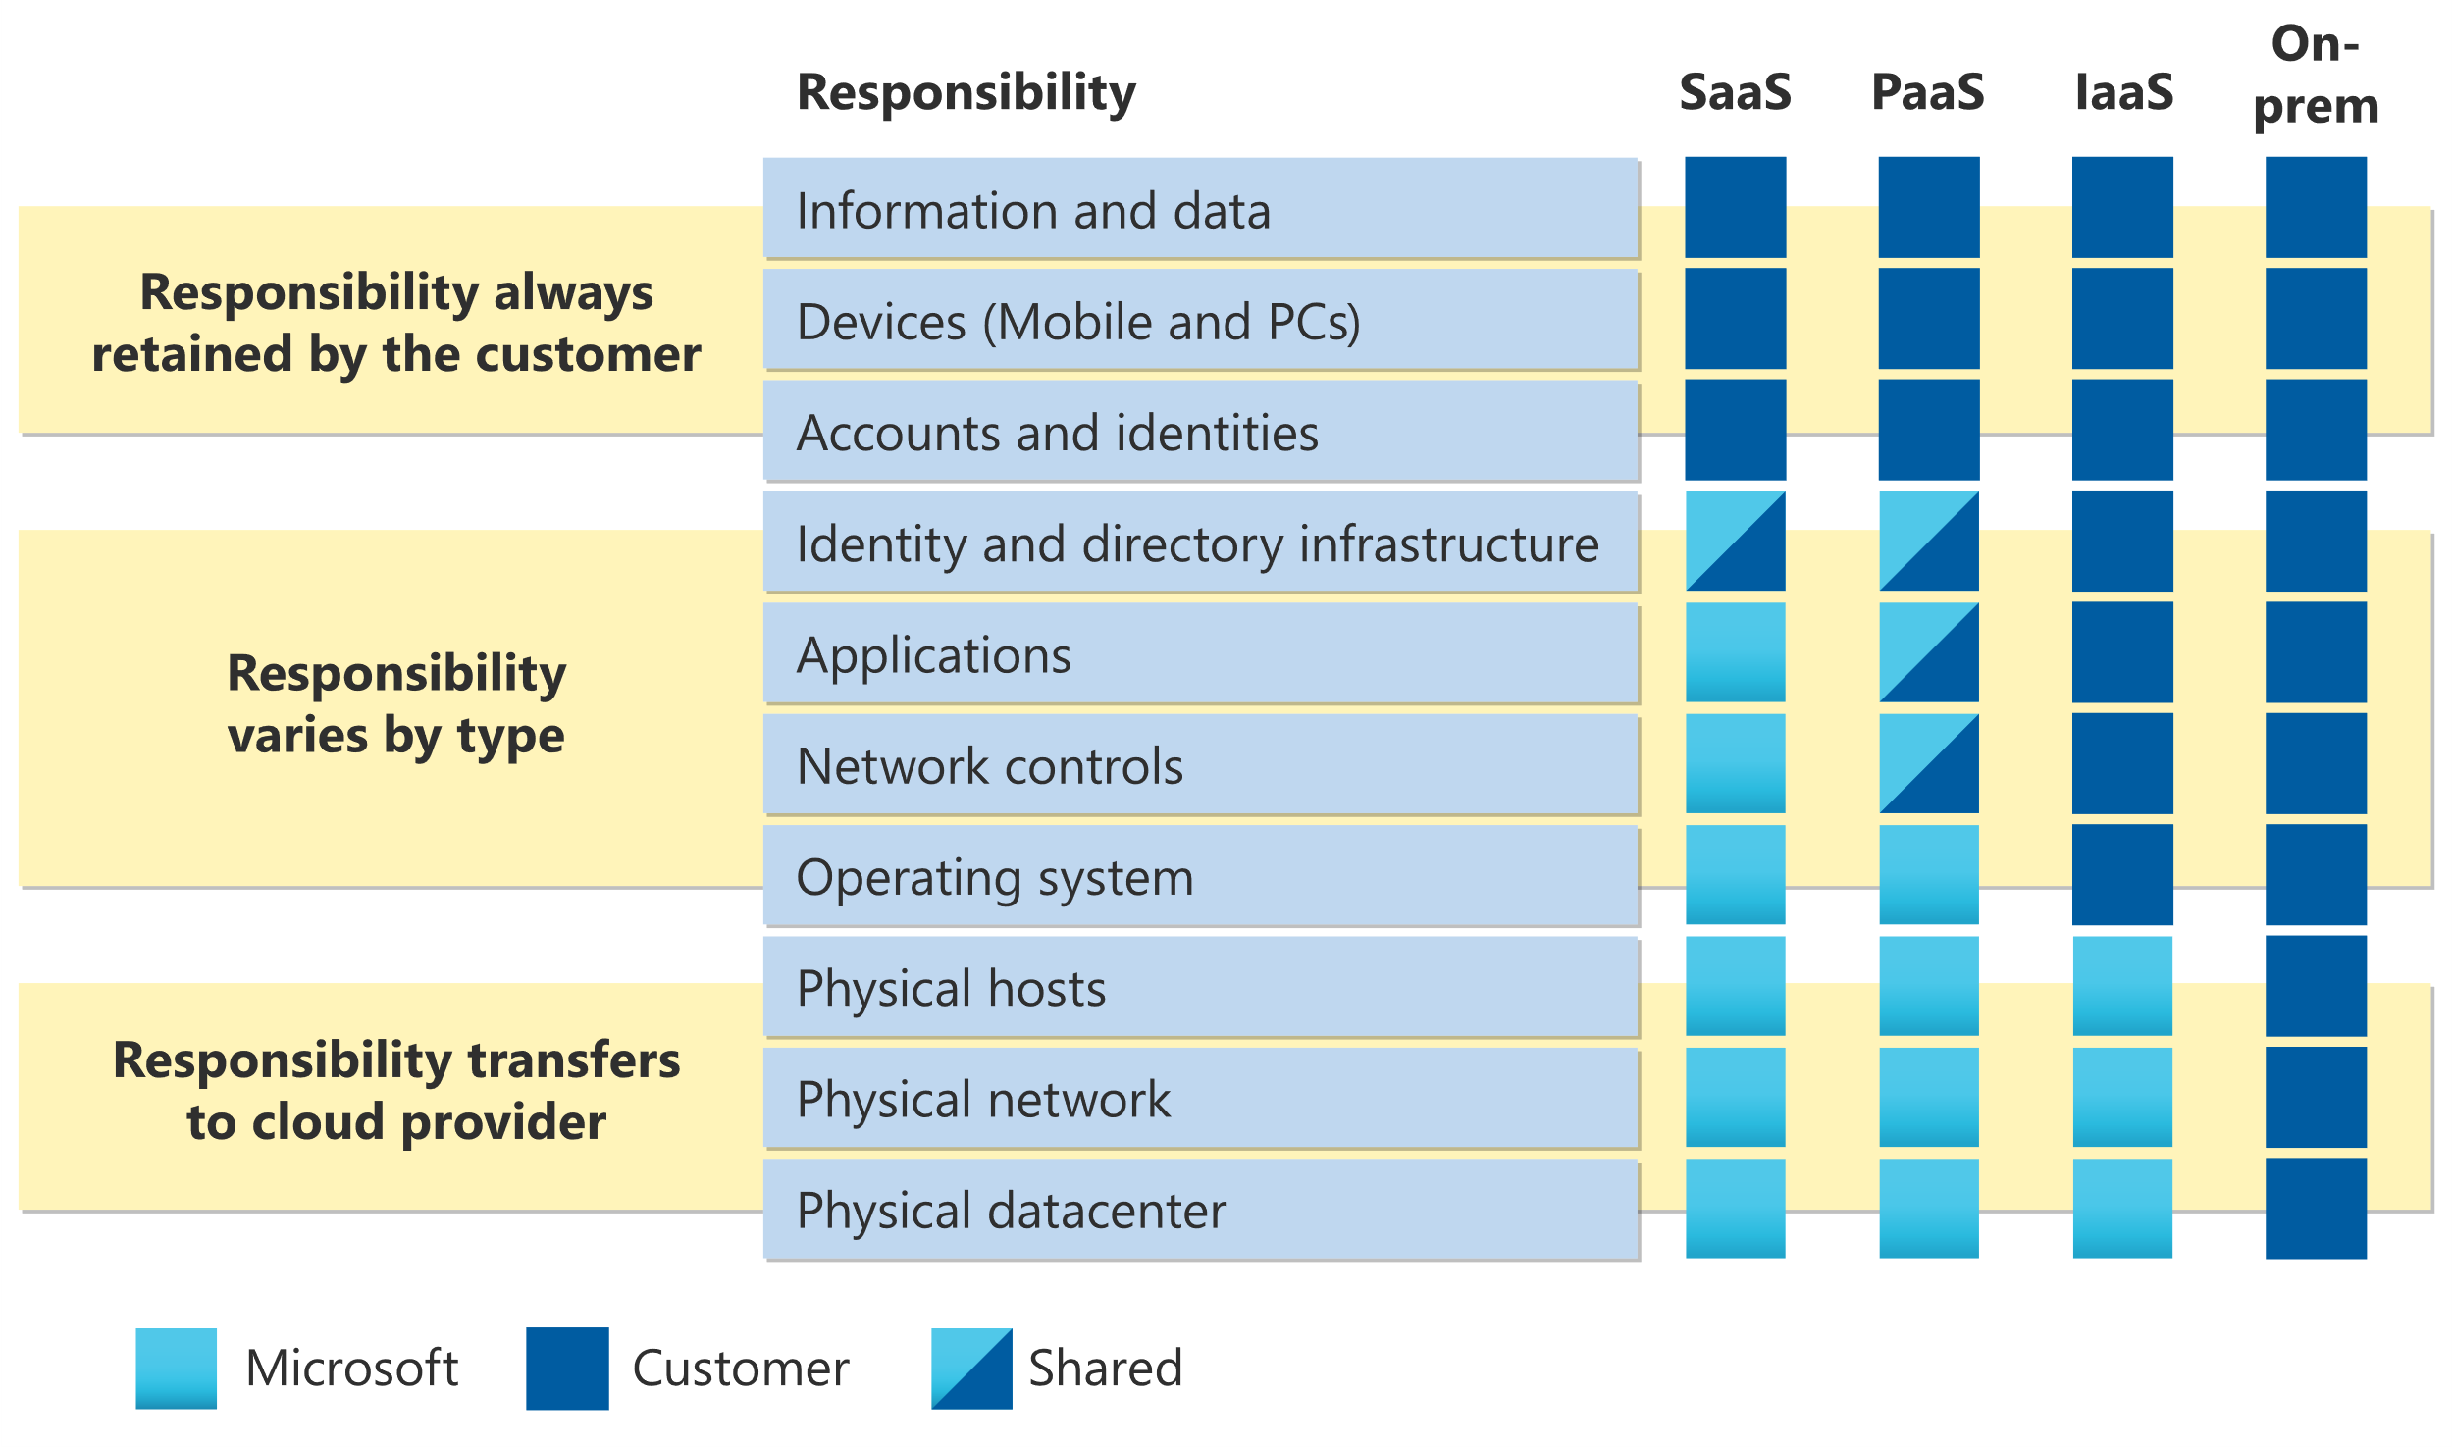
The shared responsibility model
© Copyright Microsoft Corporation. All rights reserved.

Slide 9
The shared responsibility model
You’ll always be responsible for:
The information and data stored in the cloud
Devices that are allowed to connect to your cloud (cell phones, computers, and so on)
The accounts and identities of the people, services, and devices within your organization
The cloud provider is always responsible for:
The physical datacenter
The physical network
The physical hosts
Your service model will determine responsibility for things like:
Operating systems
Network controls
Applications
Identity and infrastructure

Slide 10
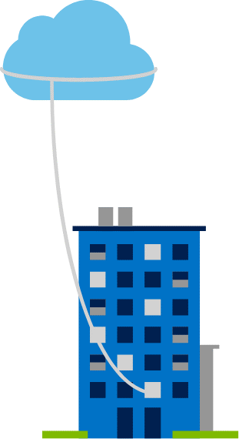
Private cloud
Organizations create a cloud environment in their datacenter.
Organizations are responsible for operating the services they provide.
Does not provide access to users outside of the organization.
Notes:
https://learn.microsoft.com/training/modules/describe-cloud-compute/5-define-cloud-models
Owned and operated by the organization that uses cloud resources.
Organizations create a cloud environment in their datacenter.
Self-service access to compute resources provided to users within the organization.
Organizations are responsible for operating the services they provide.

Slide 11
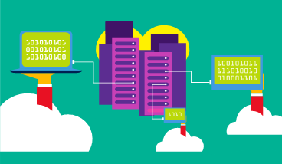
Public cloud
Owned by cloud services or hosting provider.
Provides resources and services to multiple organizations and users.
Accessed via secure network connection (typically over the internet).
Notes:
https://learn.microsoft.com/training/modules/describe-cloud-compute/5-define-cloud-models
What are public, private, and hybrid clouds? - https://azure.microsoft.com/resources/cloud-computing-dictionary/what-are-private-public-hybrid-clouds/

Slide 12
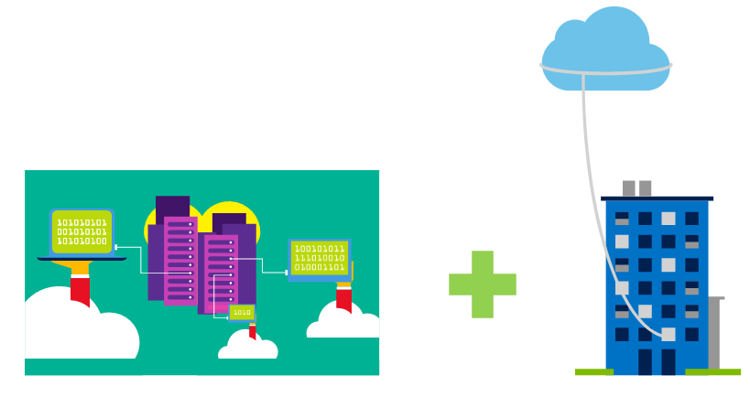
Hybrid cloud
Combines public and private clouds to allow applications to run in the most appropriate location.
Notes:
https://learn.microsoft.com/training/modules/describe-cloud-compute/5-define-cloud-models
Hybrid cloud models have the following characteristics:
Resource location. Specific resources are run or used in a public cloud―others are run or used in a private cloud.
Cost and efficiency. Hybrid cloud models allow an organization to leverage some of the benefits of cost, efficiency, and scale that are available with a public cloud model.
Control. Organizations retain management control in private clouds.
Skills. Technical skills are still required to maintain the private cloud and ensure both cloud models can operate together.

Slide 13
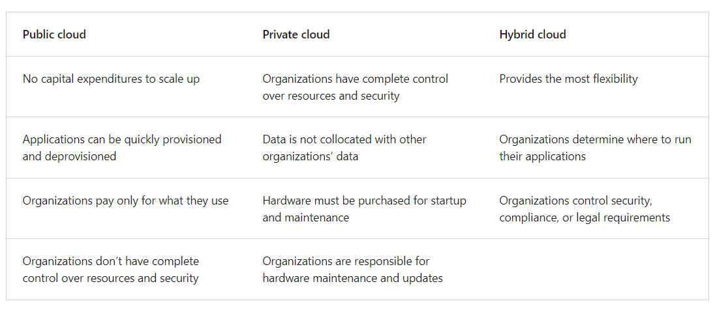
Deployment models for cloud computing

Slide 14
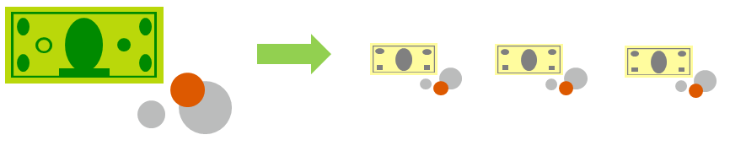
Compare CapEx vs. OpEx
Capital expenditure (CapEx)
Operational expenditure (OpEx)
The upfront spending of money on physical infrastructure.
Costs from CapEx have a value that reduces over time.
Spend on products and services as needed, pay-as-you-go.
Get billed immediately.
Notes:
https://learn.microsoft.com/training/modules/describe-cloud-compute/6-describe-consumption-based-model

Slide 15
Consumption-based model
End users only pay for the resources that they use. Whatever they use is what they pay for.
Advantages:
No upfront costs.
No need to purchase and manage costly infrastructure that users might not use to its fullest.
The ability to pay for additional resources when they are needed.
The ability to stop paying for resources that are no longer needed.

Slide 16
Cloud benefits
Notes:
https://learn.microsoft.com/training/modules/describe-benefits-use-cloud-services/

Slide 17
Advantages of cloud computing
When building or deploying a cloud application, two of the biggest considerations are uptime (or availability) and the ability to handle demand (or scale).
High availability: When you’re deploying an application, a service, or any IT resources, it’s important the resources are available when needed. High availability focuses on ensuring maximum availability, regardless of disruptions or events that may occur.

Slide 18
Advantages of cloud computing
Scalability: Scalability refers to the ability to adjust resources to meet demand.

Slide 19
Advantages of cloud computing
Vertical scaling: you could vertically scale up to add more CPUs or RAM to the virtual machine.
Horizontal scaling: you could add additional virtual machines or containers, scaling out.

Slide 20
Advantages of cloud computing
Reliability: Reliability is the ability of a system to recover from failures and continue to function. It's also one of the pillars of the Microsoft Azure Well-Architected Framework.
Predictability: Predictability in the cloud lets you move forward with confidence. Predictability can be focused on performance predictability or cost predictability.

Slide 21
Advantages of cloud computing
Performance: Performance predictability focuses on predicting the resources needed to deliver a positive experience for your customers.
Cost: Cost predictability is focused on predicting or forecasting the cost of the cloud spend. With the cloud, you can track your resource use in real time, monitor resources to ensure that you’re using them in the most efficient way, and apply data analytics to find patterns and trends that help better plan resource deployments.

Slide 22
Advantages of cloud computing
Security: Whether you’re deploying infrastructure as a service or software as a service, cloud features support governance and compliance.
set templates
Cloud-based auditing
Protection against distributed denial of service (DDoS) attacks

Slide 23
Advantages of cloud computing
Manageability: There are two types of manageability for cloud computing.
Management of the cloud speaks to managing your cloud resources. In the cloud, you can:
Automatically scale resource deployment based on need.
Deploy resources based on a preconfigured template, removing the need for manual configuration.
Monitor the health of resources and automatically replace failing resources.
Receive automatic alerts based on configured metrics, so you’re aware of performance in real time.

Slide 24
Advantages of cloud computing
Manageability: There are two types of manageability for cloud computing.
Management in the cloud speaks to how you’re able to manage your cloud environment and resources. You can manage these:
Through a web portal.
Using a command line interface.
Using APIs.
Using PowerShell.

Slide 25
Cloud service types
Notes:
https://learn.microsoft.com/training/modules/describe-cloud-service-types

Slide 26
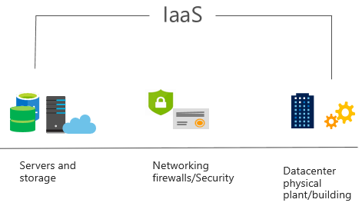
Infrastructure as a service (IaaS)
Build pay-as-you-go IT infrastructure by renting servers, virtual machines, storage, networks, and operating systems from a cloud provider.
Notes:
https://learn.microsoft.com/training/modules/describe-cloud-service-types/2-describe-infrastructure-service
For more information on IaaS, go to https://azure.microsoft.com/resources/cloud-computing-dictionary/what-is-iaas/
Most basic cloud computing services category.
Build pay-as-you-go IT infrastructure by renting servers, virtual machines, storage, networks, and operating systems from a cloud provider.
Instant computing infrastructure, provisioned and managed over the internet.

Slide 27
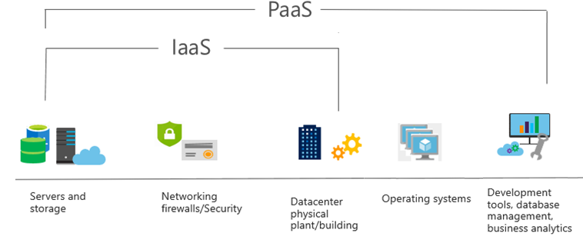
Platform as a service (PaaS)
Provides an environment for building, testing, and deploying software applications; without focusing on managing underlying infrastructure.
Notes:
https://learn.microsoft.com/training/modules/describe-cloud-service-types/3-describe-platform-service
For more information on PaaS, go to https://azure.microsoft.com/resources/cloud-computing-dictionary/what-is-paas/
Provides an environment for building, testing, and deploying software applications.
Helps create applications quickly, without focusing on managing underlying infrastructure.

Slide 28
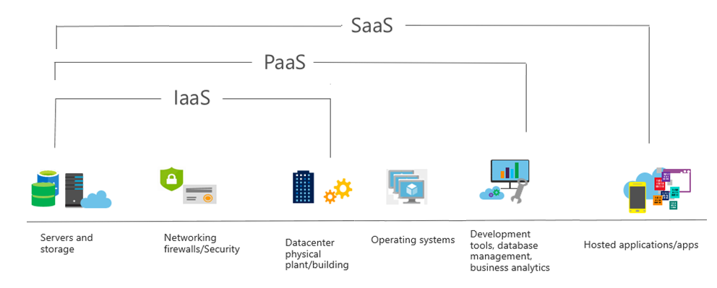
Software as a service (SaaS)
Users connect to and use cloud-based apps over the internet: for example, Microsoft Office 365, email, and calendars.
Notes:
https://learn.microsoft.com/training/modules/describe-cloud-service-types/4-describe-software-service
Common usage scenarios:
Examples of Microsoft SaaS services include Microsoft Office 365, Skype, and Microsoft Dynamics CRM Online.
For more information on SaaS, go to https://azure.microsoft.com/resources/cloud-computing-dictionary/what-is-saas/

